Slide 1

My Linear Relationships Interactive Notebook
Name:
Class:
Teacher:
Semester 2
Term 4
1

Slide 2

Interactive Notebooks!
Cover Page
Contents Page
Glossary
24/7/30
EQ
Questions
Notes
Summaries
Work page
Presentation!!!
Your book, your responsibility!

Slide 3
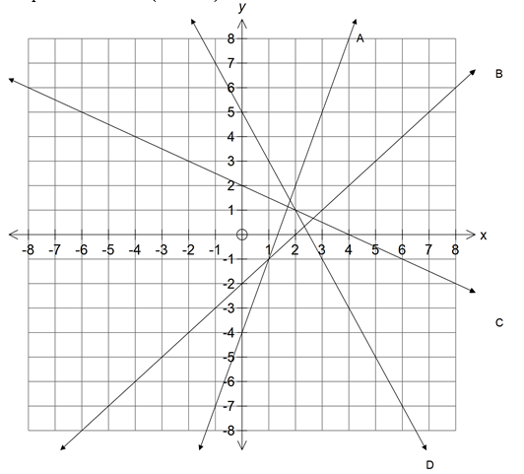
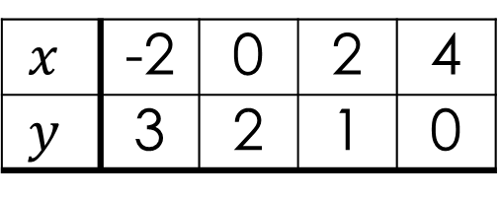
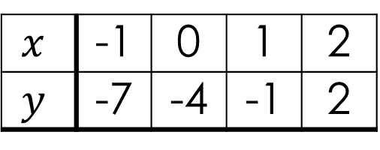
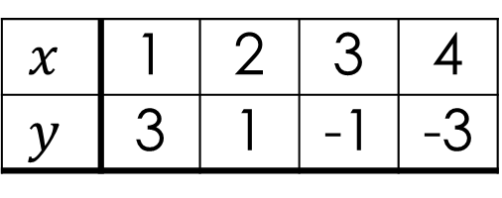
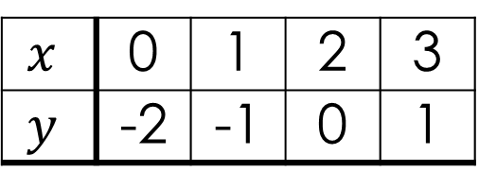
revision
Match the line on the graph to the table of values
$$x$$ | 0 | 1 | 2 | 3
$$y$$ | -2 | -1 | 0 | 1
$$x$$ | 1 | 2 | 3 | 4
$$y$$ | 3 | 1 | -1 | -3
$$x$$ | -1 | 0 | 1 | 2
$$y$$ | -7 | -4 | -1 | 2
$$x$$ | -2 | 0 | 2 | 4
$$y$$ | 3 | 2 | 1 | 0
Notes:
Give them time to write what they know on the left hand side.
How you get the info off them is up to you, TPS, popcorn etc.

Slide 4
24
7
30
Topic: Linear Relationships
Date
EQ – How do I plot a linear equation on a graph?
What is a linear equation?
A linear equation is an equation for a straight line
A linear equation links those two variables
It can be used to graph the relationship and to find the unknown variable.
For example y = 2x + 3
So how do we turn our equation into a graph?

Slide 5
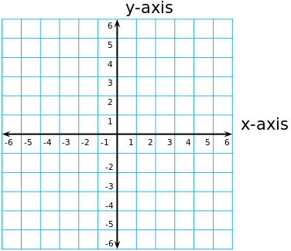
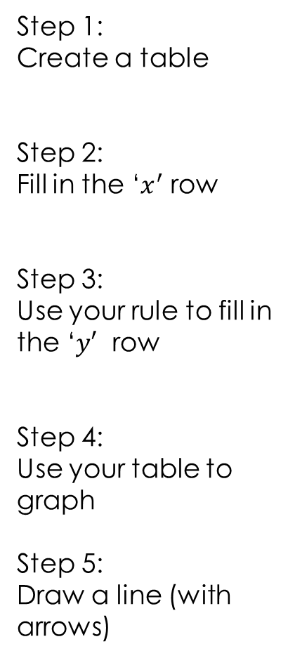

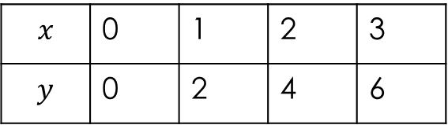
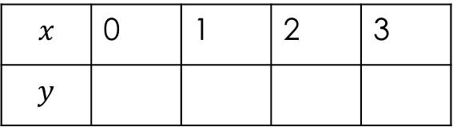
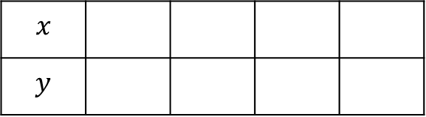
24
7
30
Topic: Linear Relationships
Date
EQ – How do I plot a linear equation on a graph?
How do I turn an equation into a graph?
Example:
$$y=2x$$
Step 1:
Create a table
Step 2:
Fill in the ‘$x^{′}$ row
Step 3:
Use your rule to fill in the ‘$y′$ row
Step 4:
Use your table to graph
Step 5:
Draw a line (with arrows)
$$x$$ | 0 | 1 | 2 | 3
$$y$$ | 0 | 2 | 4 | 6
$$x$$ | 0 | 1 | 2 | 3
$$y$$
$$x$$
$$y$$

Slide 6

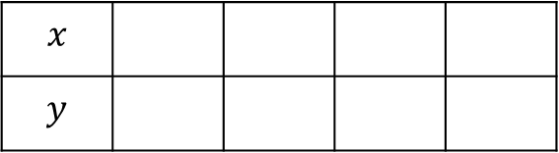
24
7
30
Topic: Linear Relationships
Date
EQ – How do I plot a linear equation on a graph?
How do I turn an equation into a graph?
Example:
$$y=x+3$$
Step 1:
Create a table
Step 2:
Fill in the ‘$x^{′}$ row
Step 3:
Use your rule to fill in the ‘$y′$ row
Step 4:
Use your table to graph
Step 5:
Draw a line (with arrows)
$$x$$
$$y$$

Slide 7

24
7
30
Topic: Linear Relationships
Date
EQ – How do I plot a linear equation on a graph?
How do I turn an equation into a graph?
Example:
$$y=3x −1$$
Step 1:
Create a table
Step 2:
Fill in the ‘$x^{′}$ row
Step 3:
Use your rule to fill in the ‘$y′$ row
Step 4:
Use your table to graph
Step 5:
Draw a line (with arrows)
$$x$$
$$y$$

Slide 8
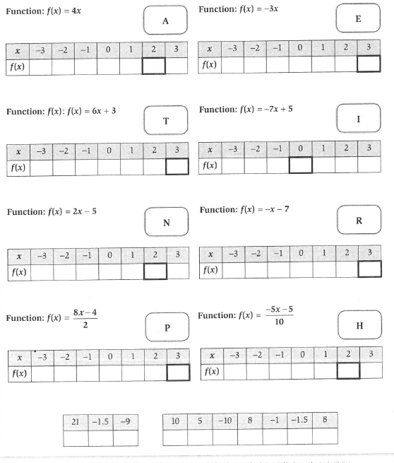
Worksheet
☺

